Slide 1

CIST 2931, Fall 2016 Weekly Report #6 11/07/2016
i c i o u s
Cnrl/alt/Delicious
Steven Alcorn, Zachary Weaver, Tyrus Skipper, Antonio Mosquera, Rupa Shrestha

Slide 2
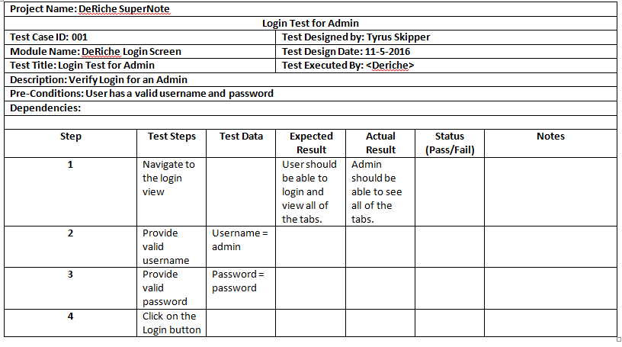
Tests
i c i o u s
Writing Test Scripts for the user to use once a deliverable is ready for them.
Notes:
Antonio

Slide 3
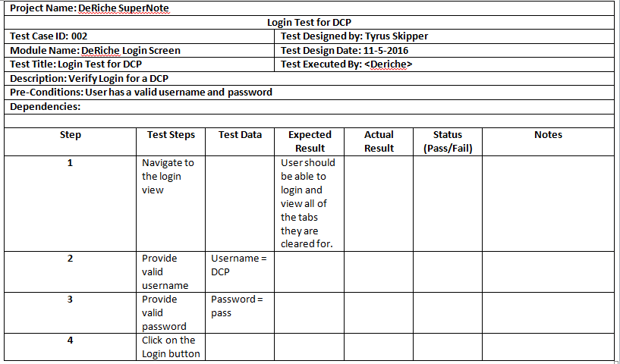

Slide 4
Code
i c i o u s
public void display (int noteID) {
System.out.println(“your note info”);
System.out.println(this.noteID);
System.out.println(this.text);
System.out.println(this.comment);
System.out.println(this.participantID);
System.out.println(userID);
System.out.println(this.isSubmitted);
System.out.println(this.isAccepted);
System.out.println(this.timeStarted);
}
Notes:
Zach

Slide 5
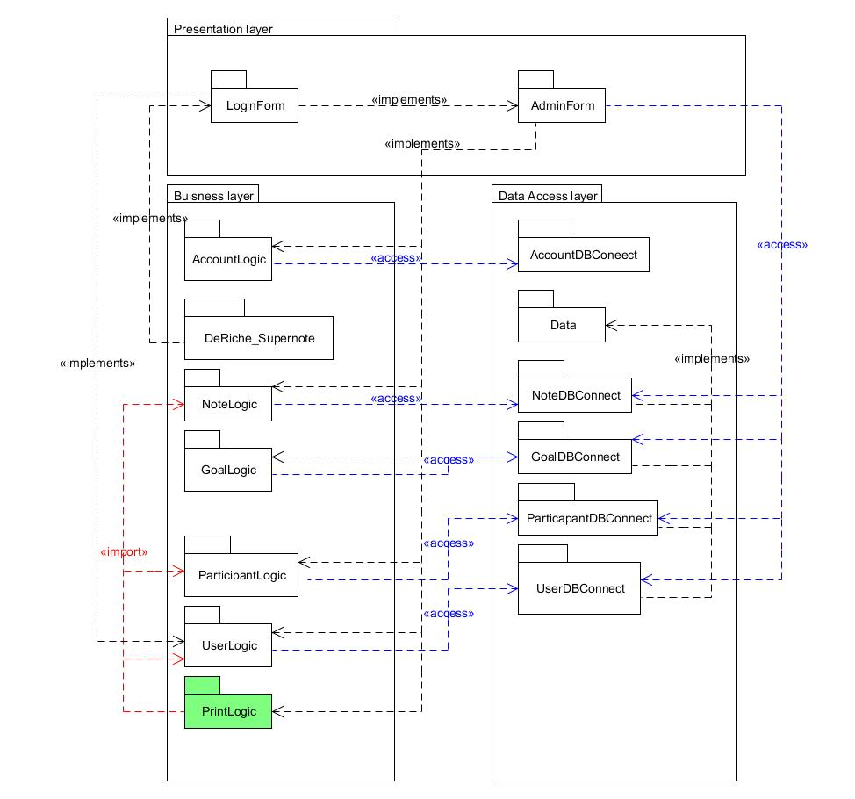
Deliverable
i c i o u s
Notes:
Steven

Slide 6
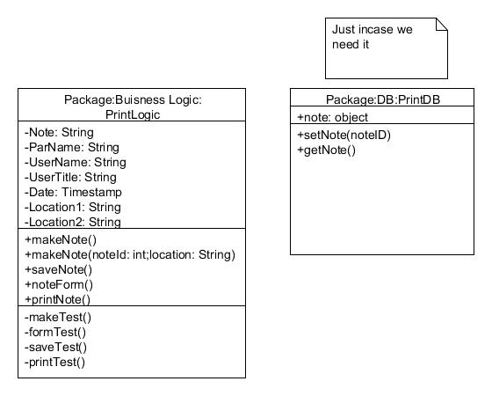
Deliverables
Notes:
Steven

Slide 7
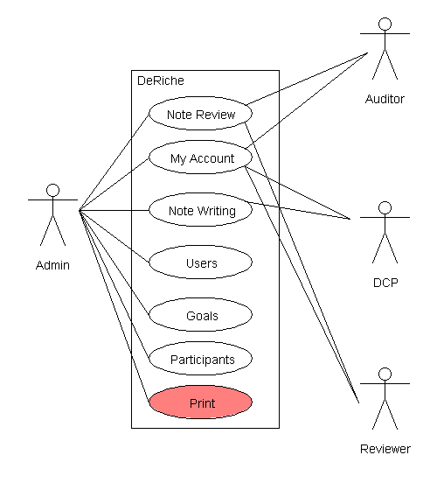
Deliverables
Notes:
Rupa

Slide 8
Project Plan
i c i o u s
Continue building the PrintLogic class
Notes:
Ty

Slide 9
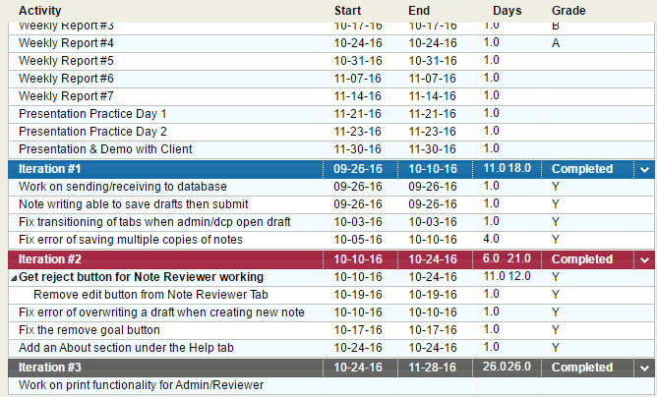
Project Plan for the Semester
Notes:
Ty

